Slide 1

Predicting Genetic Disorder
Machine learning
Tableau
11.30.2023

Slide 2

PROJECT SCOPE
Purpose & Objective:
Assess medical information of children to provide evidence-based information on the key factors that are significantly linked with the presence and absence of commonly-known genetic disorders.
The Why?:
With increasing population, studies have shown that there has been an exponential increase in the number of genetic disorders.
Low awareness about the key contributing factors and limited understanding about the importance of genetic testing contribute to the increase in the incidence of hereditary disorders.

Slide 3

Database &curation
Let’s Dive In

Slide 4
Data
Dataset
Data Characteristics
Source: Kaggle Dataset - "Of Genomes and Genetics - HackerEarth ML"
Incorporated 45 columns and more than 22,000 rows of data, with a predominant portion exhibiting null values.
278 rows identifying no genetic disorder present
Over 21,000 rows identifying presence of genetic disorder
Clear imbalance in the dataset
After preprocessing, 21 columns were eliminated, leaving 25 columns, including target and feature columns.
Data Types: Numerical & Categorical
Features: Patient Age, Genes in mother's side, Inherited from father, Maternal gene, Paternal gene, Blood cell count (mcL), Status, Respiratory Rate (breaths/min), Heart Rate (rates/min), Follow-up, Gender, Birth asphyxia, Autopsy shows birth defect (if applicable), Place of birth, Folic acid details (peri-conceptional), H/O serious maternal illness, H/O radiation exposure (x-ray), H/O substance abuse, Assisted conception IVF/ART, History of anomalies in previous pregnancies, No. of previous abortions, Birth defects, White Blood cell count (thousand per microliter), Blood test result
Target Variable: Presence or absence of genetic disorders
Use: Python Pandas, Python Matplotlib, sklearn, Tableau

Slide 5
Data Preprocessing
Handled Missing Data
Created additional "GeneticDisorder_Present" column
Assumption and Imbalance Recognition
Data Refinement
Class Imbalance Mitigation
Replaced '-' with 'Not applicable’, dropped majority of NaN values, where possible filled NaN values based on specific genetic conditions.
Introduced a new column, 'GeneticDisorder_Present,' indicating the presence or absence of genetic disorders.
Assumed that when both "Genetic Disorder" and "Disorder Subclass" columns were blank, it signified the absence of any genetic disorder in the patient.
Recognized a notable imbalance in the dataset, with a substantial prevalence of genetic disorders compared to instances with no genetic disorder.
Eliminated unnecessary columns to streamline the dataset.
Ensured data integrity by addressing duplicate rows.
Implemented Synthetic Data Generation using the make_blobs function to address the observed class imbalance.

Slide 6
Data analyses
Let’s Dive In

Slide 7
Machine learning Models
Logistic Regression:
Ideal for binary classification tasks, such as predicting the presence or absence of a genetic disorder.
Well-suited for scenarios with two possible outcomes.
Applied both on synthetic data and in an imbalanced dataset pipeline utilizing undersampling and SMOTE techniques.
Neural Network Logistic Regression:
Suited for tasks where the complexity of relationships between features and outcomes requires a more intricate model.
Offers the capability to capture non-linear patterns and relationships within the data.
Applicable when the task demands the representation learning power of neural networks combined with logistic regression.
Random Forest:
Particularly effective for tasks involving non-linear relationships and intricate patterns in the dataset.
Well-suited for handling imbalanced datasets, providing robustness in scenarios with unequal class distribution.
Offers versatility in capturing complex structures within the data, making it a strong choice for a variety of classification tasks.

Slide 8
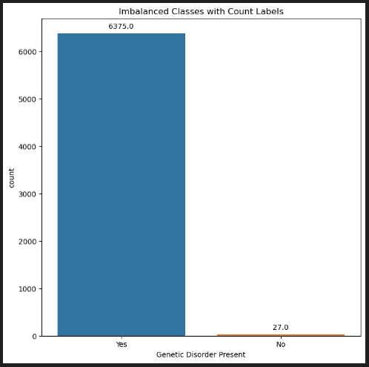
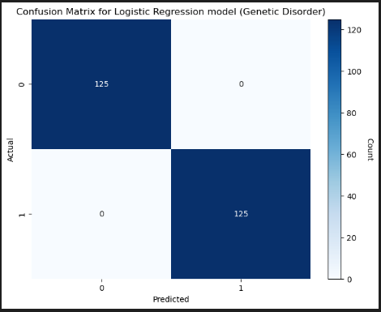
Logistics Regression
Synthetic data generation and logistic regression model building
Used the make_blobs function to generate synthetic data for testing purposes
Balanced accuracy score for the model was 1.0
No false positives or false negatives identified
Model Overview:
Each sample comprises 24 features.
Created a binary classification task with 2 centers.
Set the random seed to 1 for reproducibility using the random_state parameter.
Introduced a cluster standard deviation of 2 using the cluster_std parameter.

Slide 9
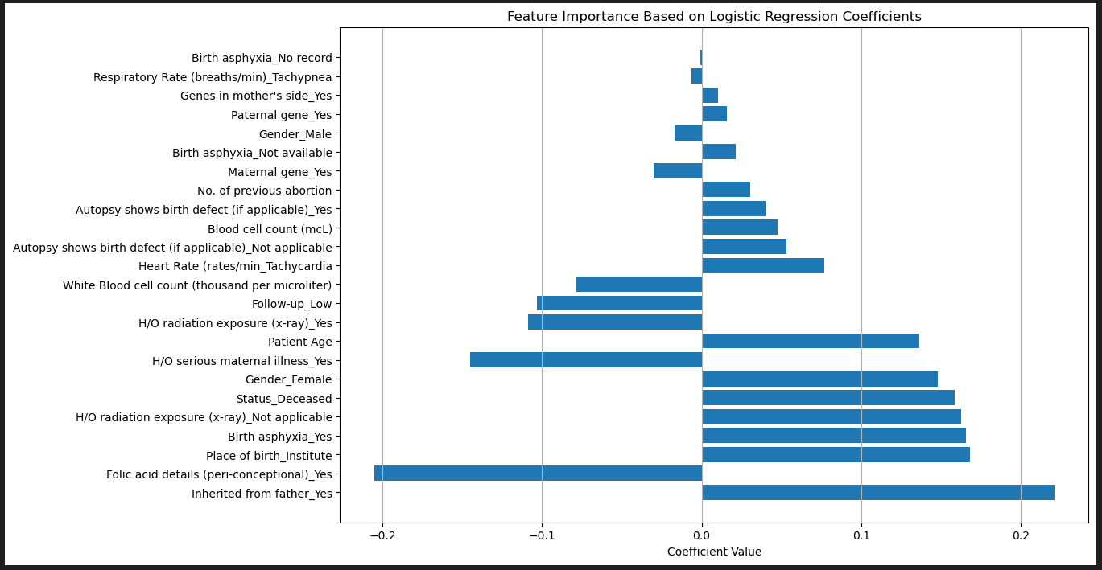
Feature importance
Feature coefficients shed light on the significance of various factors in predicting genetic disorders​

Slide 10
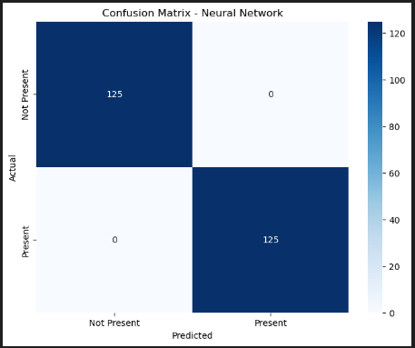
Logistics Regression
Training a simple neural network, and evaluating its performance
The neural network model is trained on the training data (X_train_scaled and y_train) for 100 epochs.
Logistic regression model accuracy: 1.00
Outcome aligns with the Logistics Regression Model using synthetic data generation
Network Architecture Overview:
Input layer with 24 dimensions.
Two hidden layers with 16 units each, employing "relu" activation.
Output layer with a single unit using the "sigmoid" activation for binary classification.

Slide 11
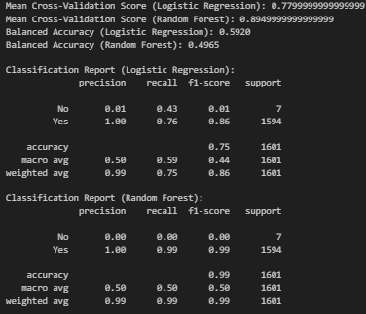
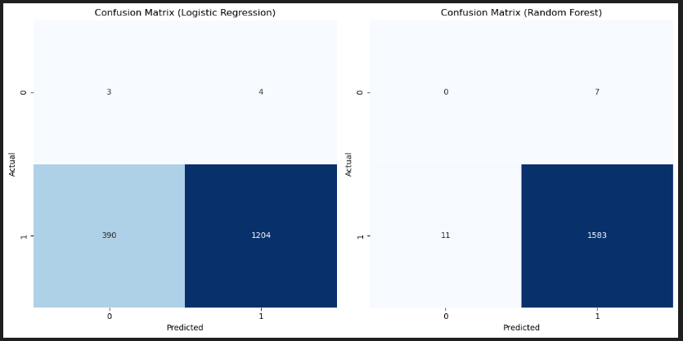
Logistics Regression
Real-world medical data, class imbalance, and logistic regression model building
Used a Logistic Regression and Random Forest models trained on resampled data, with an imbalanced pipeline including undersampling and SMOTE (Synthetic Minority Over-sampling Technique).
Balanced Accuracy (Logistic Regression): 0.5920
Balanced Accuracy (Random Forest): 0.4965
The imbalanced class distribution, especially for the "No" (Genetic Disorder Not Present) class, impacted model performance.
Further addressing class imbalance, exploring features or interactions, and tuning model hyperparameters could improve performance.

Slide 12
TABLEAU
Visuals

Slide 13
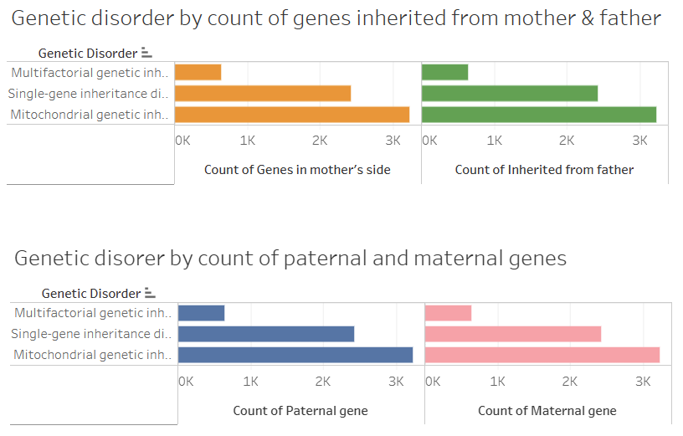
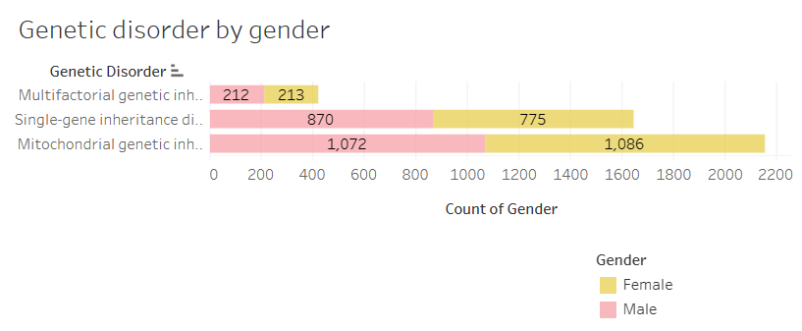
Tableau Findings
The largest number of patients in the dataset are diagnosed with Mitochondrial disorder.
Genetic disorder by count of maternal & paternal genes are highest for Mitochondrial disorders followed by single-gene inheritance and thirdly by Multifactorial disorders.
The number of female patients is slightly higher than male patients in the cases of Mitochondrial and Multifactorial genetic disorders.
Genetic disorder_dataset | Tableau Public

Slide 14
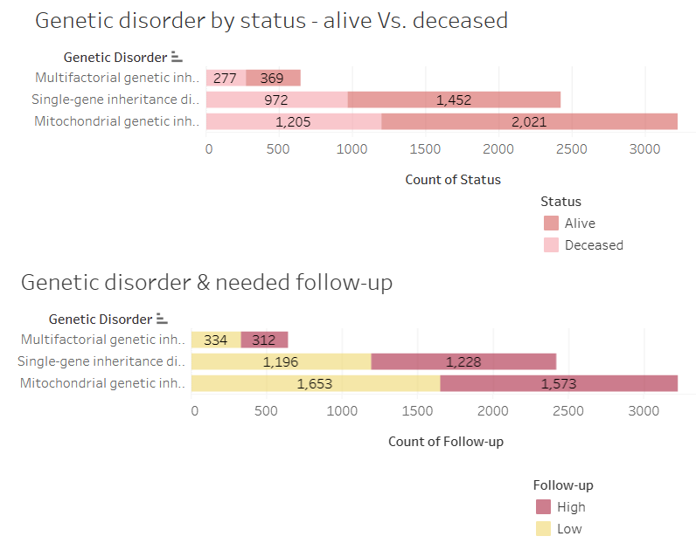
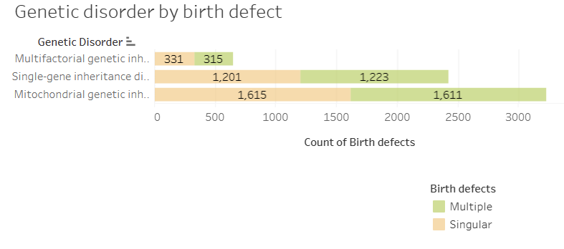
Tableau Findings
The number of patients alive is higher than deceased patients in all three categories of genetic disorders.
Higher number of patients diagnosed with single-gene disorder require high follow-up and also have multiple birth defects.
For the other two categories, higher number of patients need low follow-up and are diagnosed with singular birth defects.
Genetic disorder_dataset | Tableau Public

Slide 15
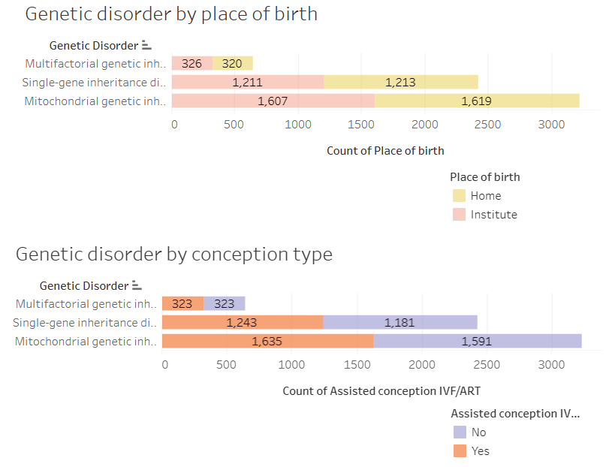
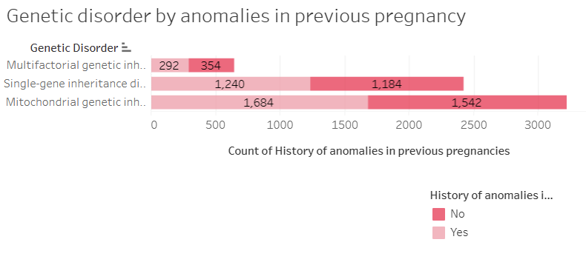
Tableau Findings
Slightly higher number of patients diagnosed with Mitochondrial and Single-gene disorders were:
(1) conceived with IVF/ART,
(2) born at home,
(3) with history of anomalies in their families' previous pregnancy.
These numbers are lower for patients diagnosed with Multifactorial disorders.
Genetic disorder_dataset | Tableau Public

Slide 16
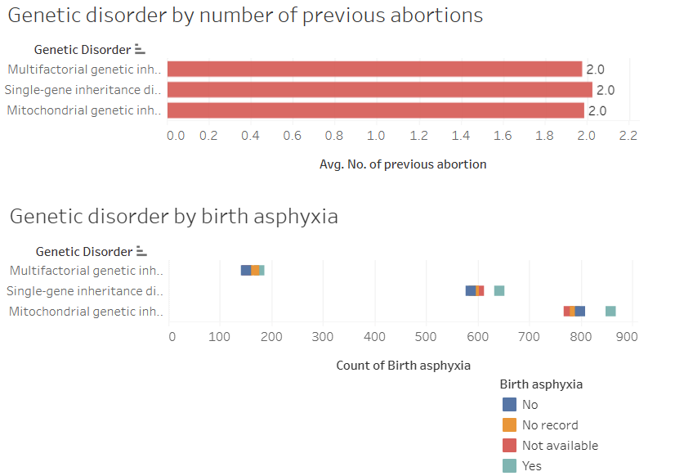
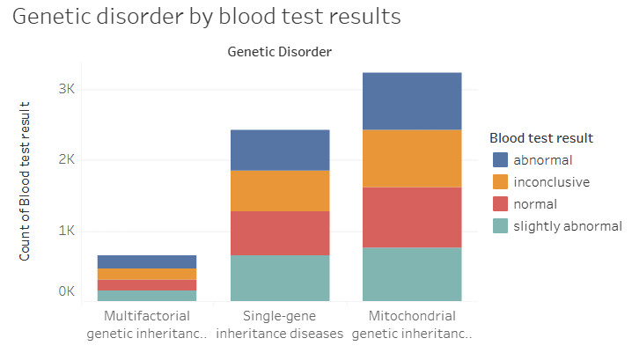
Tableau Findings
In all three categories of genetic disorder, there were two previous abortions on average.
The number of patients with birth asphyxia is slightly higher in all three cases.
The number of patients with combination of abnormal, inconclusive and slightly abnormal blood test results are higher for all three cases of disorder.
Genetic disorder_dataset | Tableau Public

Slide 17
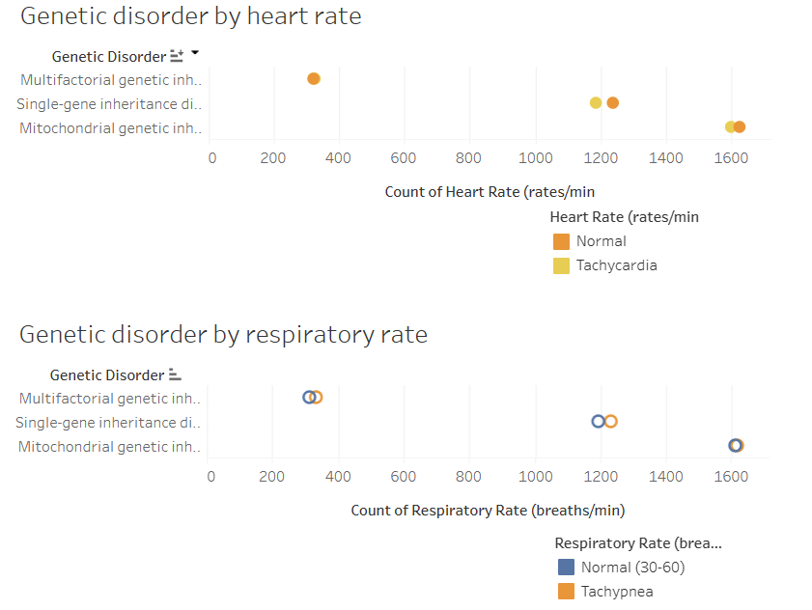
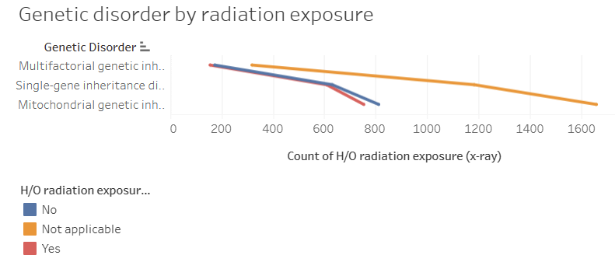
Tableau Findings
In all the three cases of genetic disorder,
(1) the number of patients with radiation exposure is lower,
(2) slightly higher number of patients have normal heart rates, while the remaining half patients have Tachycardia, and
(3) slightly higher number of patients have Tachypnea, while the remaining half patients have normal respiratory rates.
Genetic disorder_dataset | Tableau Public

Slide 18
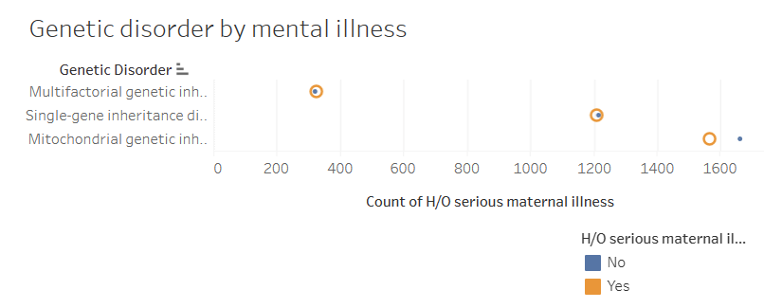
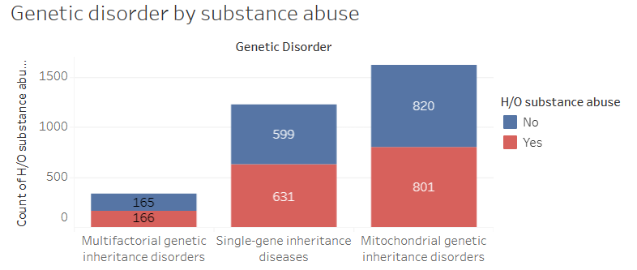
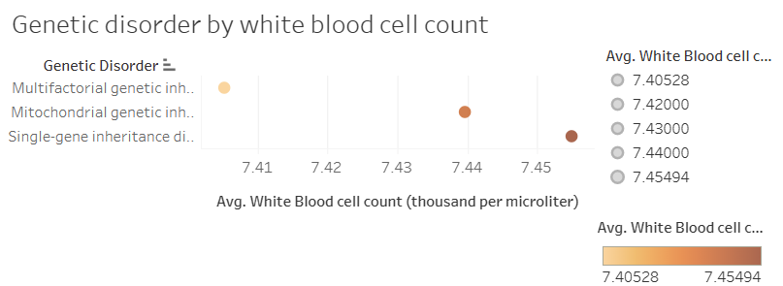
Tableau Findings
Average white blood cell count of patients is around 7.4. Patients diagnosed with single-gene inheritance have higher counts.
Number of patients with history of substance abuse is slightly lower in all three cases of genetic disorder.
The number of patients with history of mental illness is almost equivalent to the number of patients with no mental illness history in all cases.
Genetic disorder_dataset | Tableau Public

Slide 19
Data analyses
Challenges
Data Manipulation: Evident signs of previous data manipulation on the Kaggle dataset were observed, leading to the exclusion of a substantial number of patients lacking a genetic disorder in the original dataset.
Missing Data Handling: Strategies were implemented to address the widespread issue of missing data, which included replacing values and filling NaN entries based on specified conditions where possible or dropping NaN values.
Categorical Data Management: Categorical data underwent one-hot encoding to ensure compatibility with machine learning algorithms.
Imbalanced Data Addressal: An effort was made to mitigate imbalanced data by introducing a new column, 'GeneticDisorder_Present,' thereby transforming the task into a binary classification problem focused on classifying the presence or absence of genetic disorders.
Data Preprocessing Challenges: The exploration encompassed various challenges in data preprocessing, including the management of missing values, transformation of specific columns, and the resolution of imbalances within classes.

Slide 20
conclusion
Key contributing factors towards genetic disorders
Gene inherited from Father (Gene Defect), Place of Birth (birth at Institutions), and presence of Birth Asphyxia significantly and positively contribute to genetic disorders.
History of serious mental illness and folic acid details (peri-conceptional) significantly and negatively contribute towards genetic disorders.
Inferences
Earlier genetic testing will direct people toward available prevention, monitoring, and treatment options.
Due consideration for folic acid details and birth asphyxia (oxygen and blood flow to brain) is critical in preventing, monitoring and preparing to treat genetic disorders.
ML Potential: Logistic Regression demonstrates promising potential in predicting genetic disorders.
Data: Real-world data is often messy and exhibits gaps.
Essential Steps: Emphasis is needed on the significance of data preparation, model evaluation, and comparison in healthcare ML applications.
Future Exploration: Additional data gathering and refining is needed to enhance ML applications in healthcare.

Slide 21

THANK YOU
Starla Halliday
Mosa Hassan
Robert Takan
Yemesrach Gebremikael

